Slide 1
AI & Automation
Tomás Dodds | Leiden

Slide 2
AI in Journalism
As the social impact of artificial intelligence (AI) is growing, so do concerns around safety, fairness, responsibility, and the ethics related to the use of these technologies.
As Lu et al. argue, “Compared to traditional software systems, AI systems involve a higher degree of uncertainty and more ethical risk due to their dynamic, autonomous, and opaque decision-making and historical-data-dependent behaviors” (2023, p. 1)
But what is AI? Artificial intelligence is difficult to define, but in practice, it typically takes the form of ‘narrow’ computer systems that focus on specific tasks and problems usually associated with human abilities.
Within the news industry, AI “serves as an umbrella term to encompass a range of technologies and is commonly understood by many as the computational simulation of human activities and skills in specific domains” (Simon & Isaza-Ibarra, 2023).

Slide 3
AI in Journalism
AI is increasingly shaping journalistic work.
A growing number of journalists and news workers nowadays use AI to automate tasks (such as translation or transcription of content) or aid in other news tasks, for example, investigative work.
News organizations also employ AI on the distribution side, for example, to optimize paywalls and recommend content to users.

Slide 4
AI in Journalism
Recent studies have shown that news workers are struggling with both technical and cultural challenges around the integration of AI in newsrooms (Gutierrez Lopez et al., 2023).
On the one hand, as Simon (2022) argues, financial limitations and technical difficulties make it challenging for news organizations to develop AI-based technologies without relying on US-based platform companies and other external vendors who control much of the current AI infrastructure.
On the other hand, Beckett and Yaseen (2023) show how media managers are not only struggling with technical issues that stem from a lack of resources. Instead, as they put it, “mitigating AI integration challenges […] requires bridging knowledge gaps that exist among various teams in the newsrooms, a challenge that is more consistent across the board” (p. 33).

Slide 5
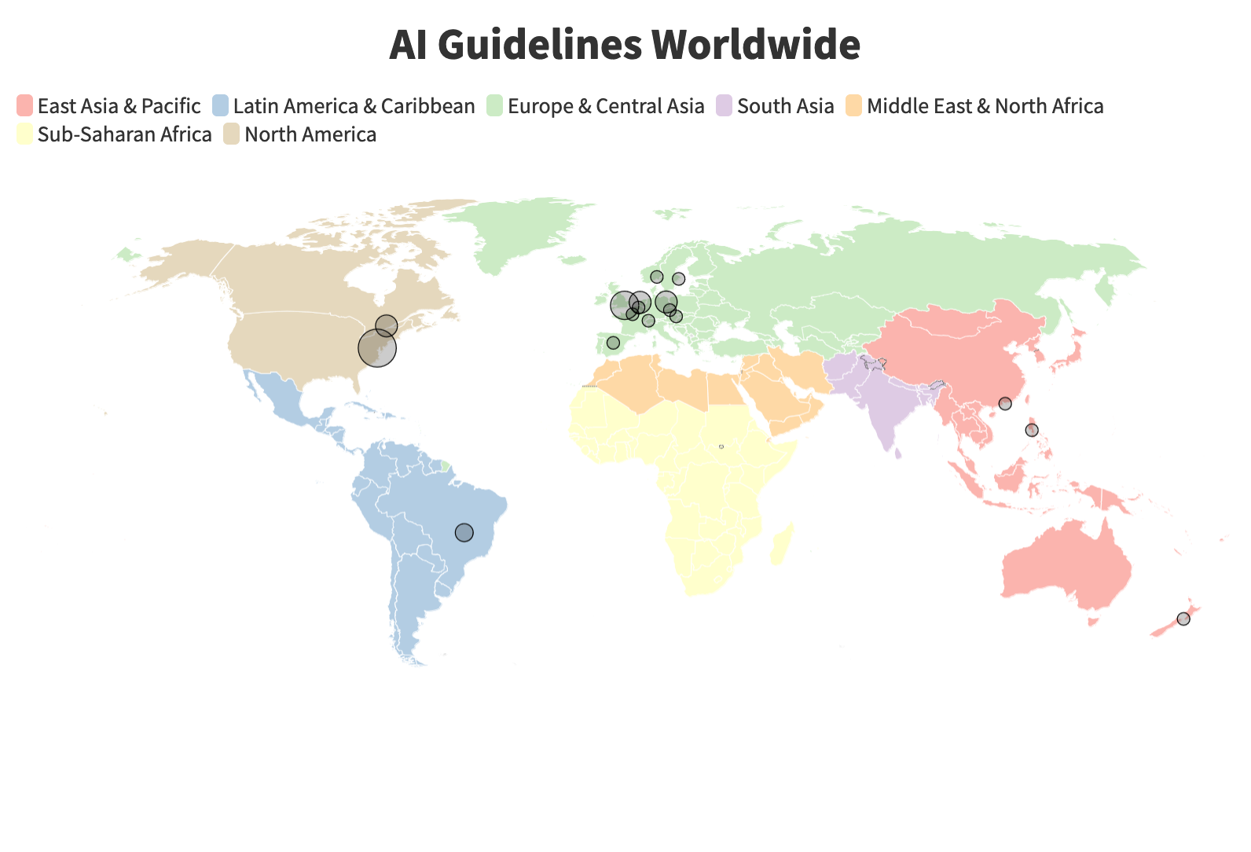
Guidelines
Notes:
37 AI guidelines for media purposes in 17 countries

Slide 6
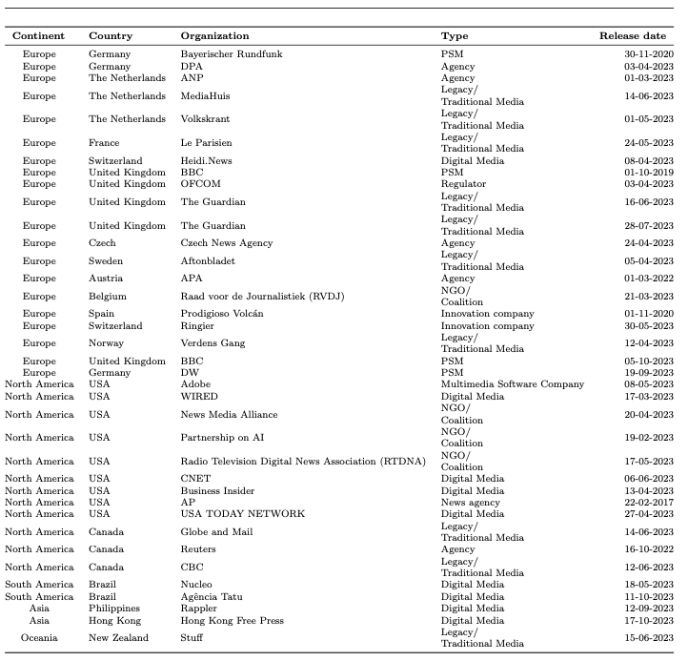
Guidelines

Slide 7

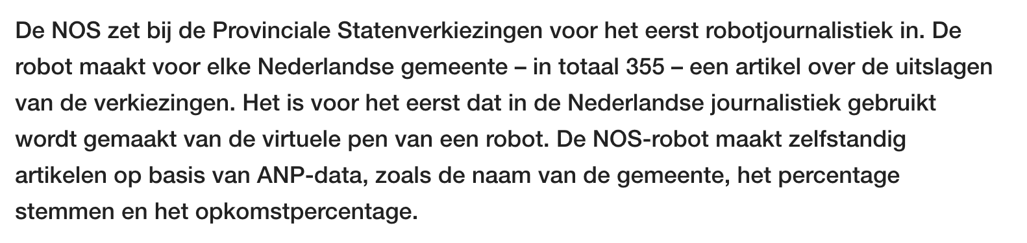
AI in Dutch Journalism

Slide 8
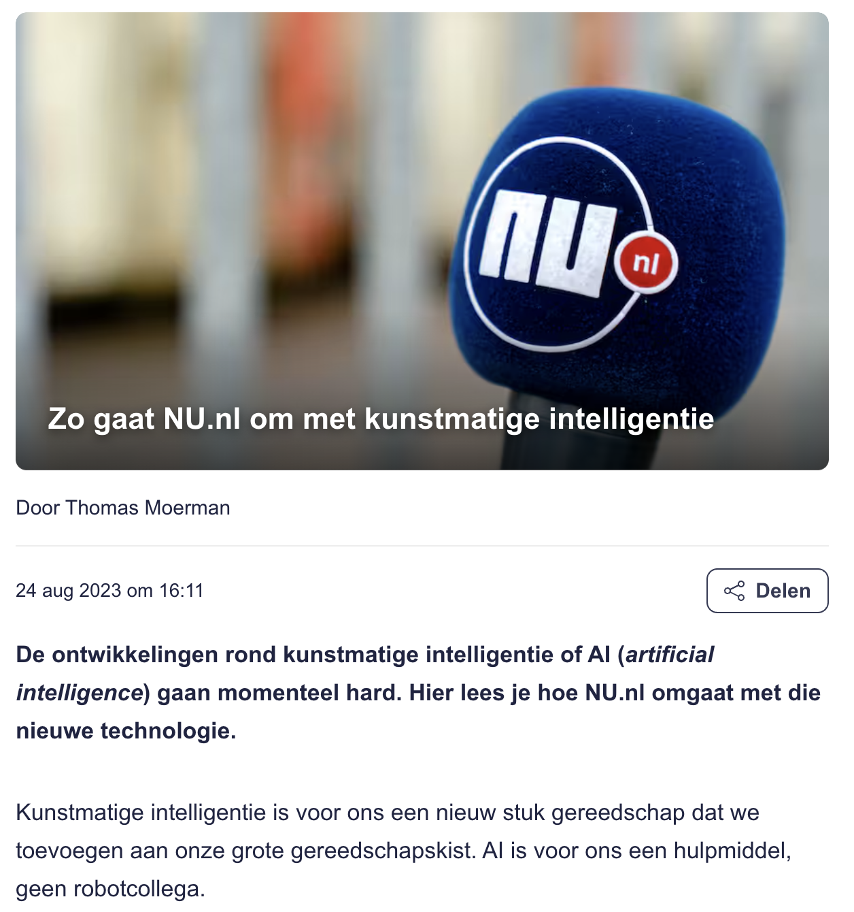
AI in Dutch Journalism

Slide 9
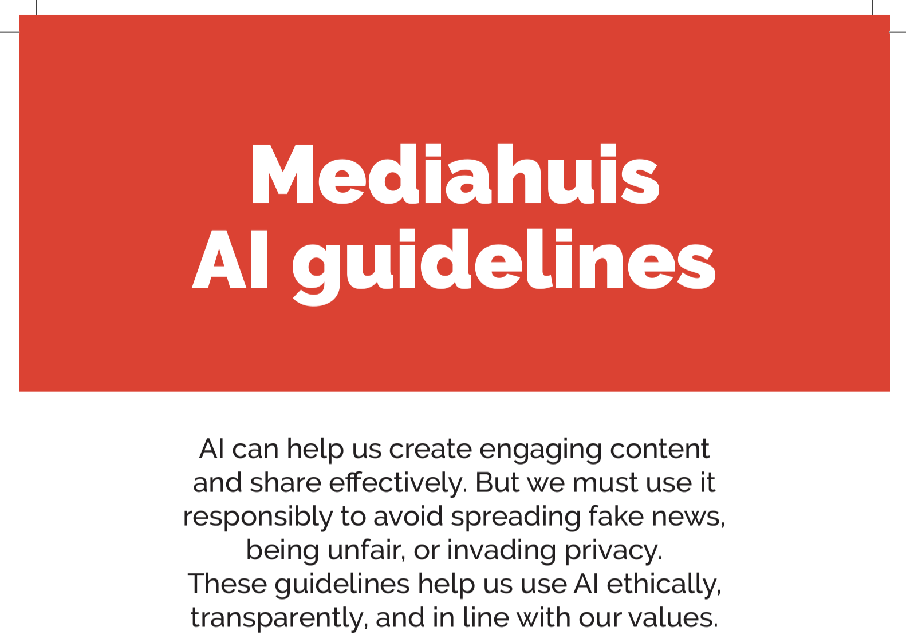
AI in Dutch Journalism

Slide 10
Guidelines
Our analysis reveals key thematic areas, such as transparency, accountability, fairness, privacy, and the preservation of journalistic values.
Results highlight shared principles and best practices that emerge from these guidelines, including the importance of human oversight, explainability of AI systems, disclosure of automated content, and protection of user data.

Slide 11
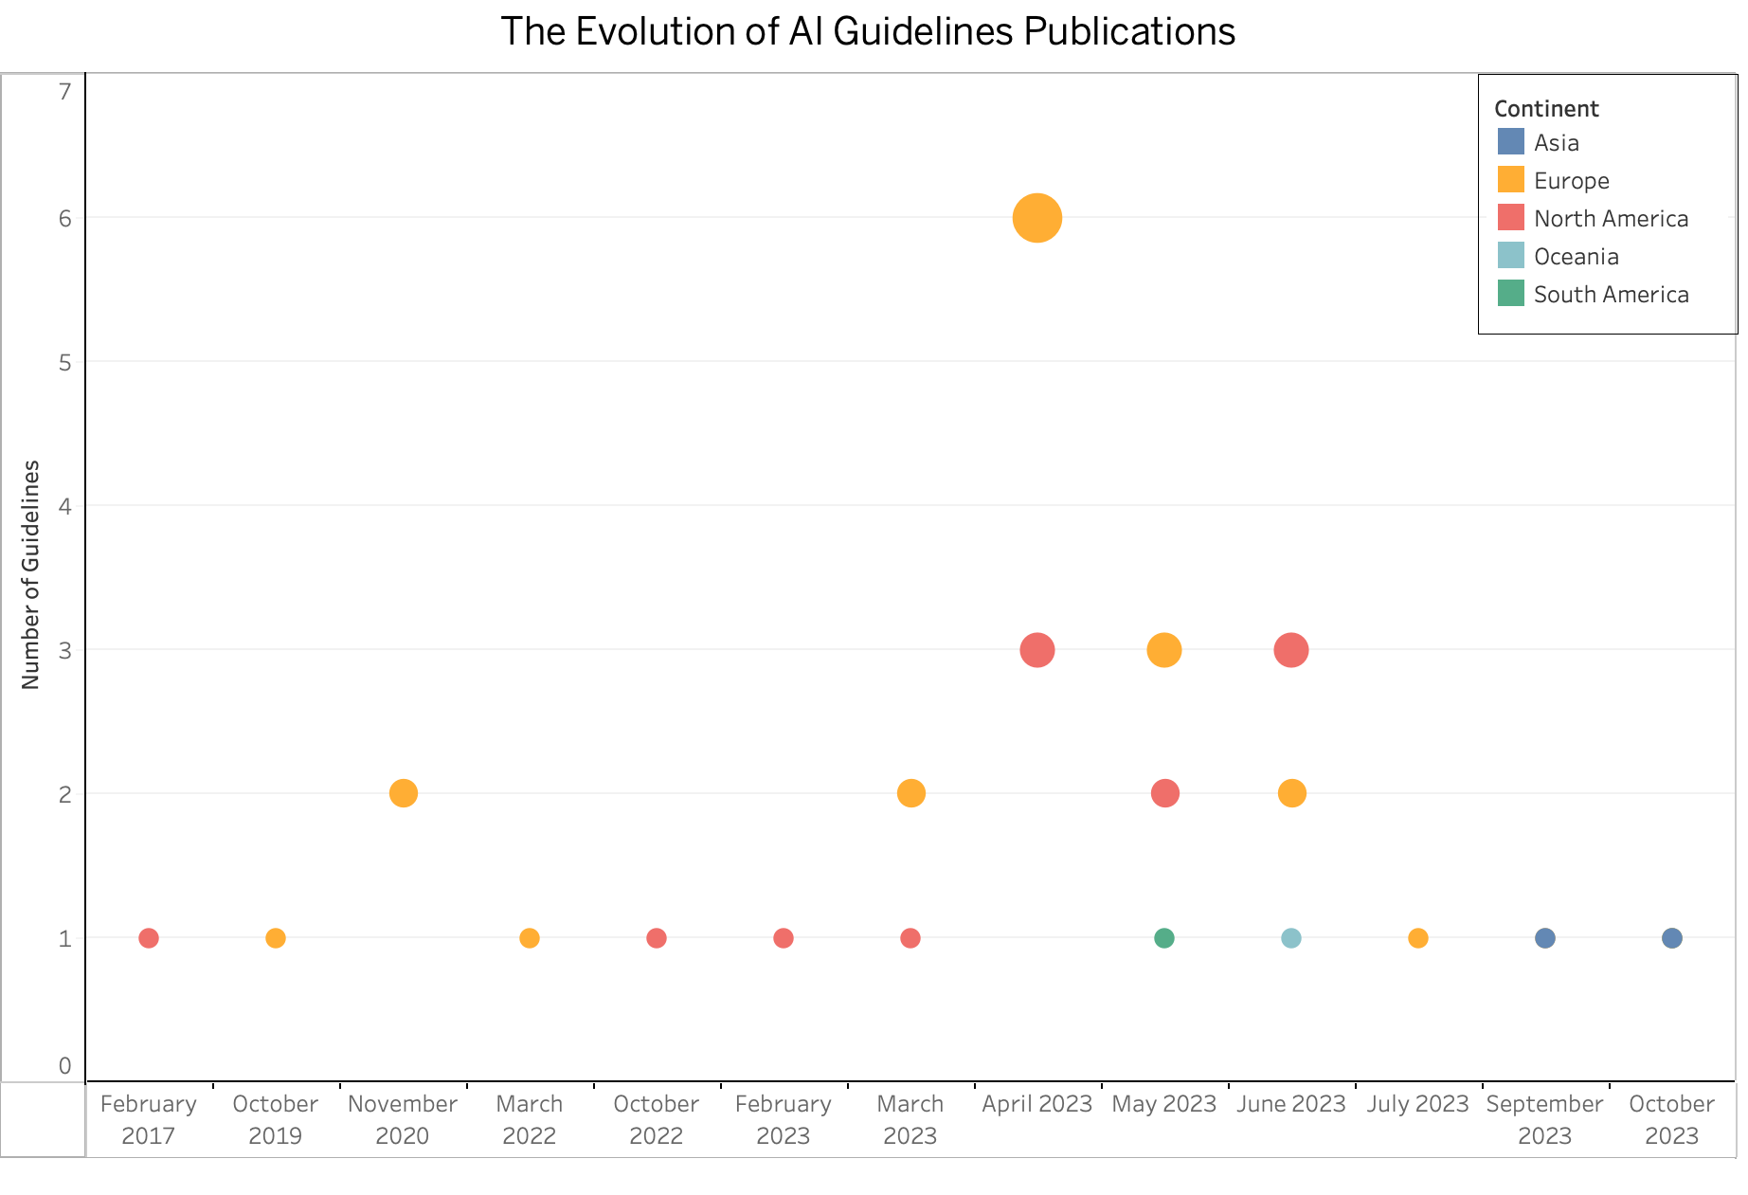
Guidelines

Slide 12
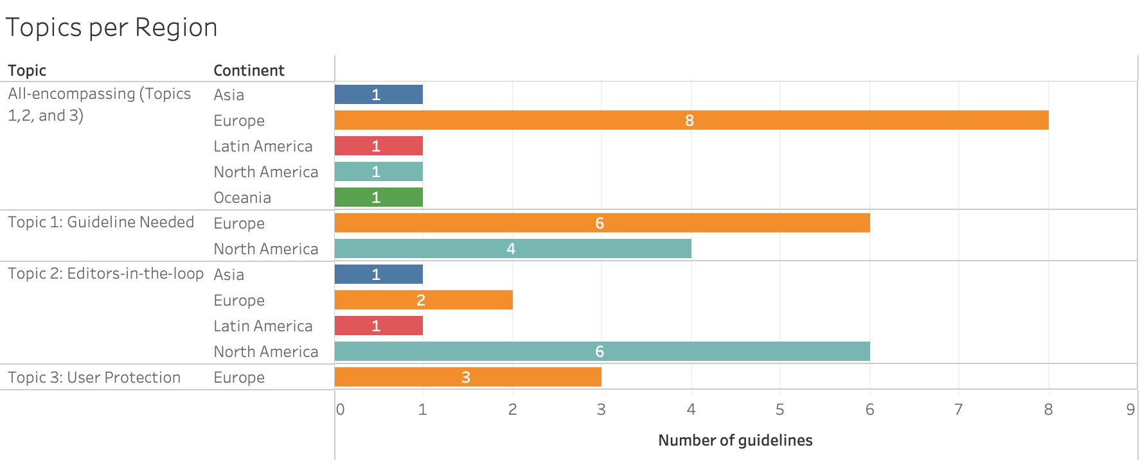
Guidelines

Slide 13
Isomorphism
Organizations strive for legitimacy by emulating other actors in their environments.
Their behavior responds by integrating “correct” programs and structures from their fields, which are perceived as legitimate by other institutions, reflecting efficiency and indicative of quality output.
Over time, this incorporation of elements drives institutional isomorphism, influenced by pressures that aim to increase an organization’s likelihood of survival within its environment.
Isomorphism, defined as a constraining process that drives one unit in a population to resemble other units facing the same set of environmental conditions, can manifest through three mechanisms: coercive (pressures from competitors or cultural expectations), normative (progressive professionalization in the field), and mimetic practices (emulating paths already tested by preceding institutions and actors)

Slide 14
Responsible AI
It is in this context that the expanding field of responsible AI in journalism emphasizes the necessity of ethical and accountable AI systems development, deployment, and usage inside newsrooms (Trattner et al., 2022).
Rather than exclusively focusing on the faults and foibles of how media workers use these systems, the concept of responsible AI demands that AI-based systems and the companies that develop and deploy them (see Kak et al., 2023) adhere to societal values and human rights and prevent detrimental outcomes (Dignum, 2019), particularly for journalists and news organizations, where AI brings forth both unique challenges and opportunities (Fridman et al., 2023).
In response to these challenges, various news organizations have initiated steps to address the ethical implications of AI (Becker et al., 2023). Wired, for instance, was one of the first to establish ground rules for using generative AI, emphasizing ethical usage and transparency. The magazine decided against publishing stories with text generated or edited by AI, except when AI’s involvement is central to the story (Tobitt, 2023).

Slide 15
Responsible AI
Efforts to address and mitigate these challenges regarding the use of AI are often grouped under the label ‘Responsible AI.’ While it lacks a clear definition, the term is often used to describe specific organizational choices and practices around AI and refer to the emerging area of AI governance, which focuses on the ethical and accountable development, deployment, and use of artificial intelligence systems
Three distinct categories that repeatedly feature in the wider literature on digitalization and automation in the news focus on
(1) upholding professional values inherent to journalistic practices, such as objectivity and accuracy,
(2) adhering to legal frameworks governing technological applications (and AI) in journalism and
(3) considering democratic obligations associated with journalism and the societal impact of AI in news.

Slide 16
Information Sharing and Knowledge Silos
Journalists rarely operate independently. Instead, they are embedded in formal and informal structures (Clement & Puranam, 2017), with the social context of a news organization (Singer, 2004) shaping their work.
Research into knowledge management has demonstrated that, among other things, such organizational settings can both enable and constrain knowledge sharing – not just between journalists but also between the newsrooms and other parts of the organization.
Such ‘knowledge silos’ – “individuals or higher-level collectives that serve as heterogeneously distributed repositories of knowledge” (Phelps et al., 2012, p. 1117) arise in many organizations, in some cases on purpose.
Especially in large organizations, operating in silos and compartmentalization (for example, departments) can lead to greater efficiency or make functioning possible in the first place (de Waal et al., 2019)

Slide 17
Information Sharing and Knowledge Silos
The effects can be problematic. Knowledge silos are often blamed for hindering innovation, decision-making, and overall organizational performance. They are also seen as impeding the flow of information, limiting the cross-pollination of ideas within the organization, and preventing the organization from capitalizing on the collective intelligence of its staff.
We theorize that knowledge silos and the lack of information sharing also affects the adoption and implementation of responsible AI practices. Consequently, this study aims to explore if, and if so, how different dimensions of knowledge silos (i.e., individual, departmental, technological, and cultural) affect the adoption of responsible AI practices in journalism. To answer this question, we focus on four major media outlets in the Netherlands.

Slide 18
Results
The challenges of knowledge silos within professional environments are multidimensional, as highlighted by our interviews with newsroom personnel. During our interviews, editors often mentioned a knowledge gap between themselves and colleagues with different technical backgrounds. We have named these “horizontal silos” and “vertical silos.” These silos impede the seamless integration of technology and collaboration across different levels and areas of experience within an organization.
The notion of horizontal silos is exemplified by an editor from de Telegraaf. While discussing the integration of machine learning and natural language processing tools into their daily tasks, the de Telegraaf editor stated: “Oh, I find it very difficult to explain. [My colleague, a tech journalist] probably knows more about that. He knows about numbers.”
Interestingly, while this editor suggests a knowledge barrier between the editorial and technical staff, this admission also highlights a disconnect, not only in understanding but in confidence, when it comes to the domain of machine learning, which is already in use in the editor’s newsroom.
It is telling that the editor associated technological expertise with proficiency in numbers, suggesting a stereotypical view that may further entrench these silos.

Slide 19
Results
We found something similar when interviewing an editor from RTL, who claimed, “I am sitting here, in my management room, thinking about what the editors should do about AI, while my journalists, of course, already have a much better feeling about these tools from using them.” These findings point to a possible need to pay attention to how horizontal silos could be impacting the processes of production inside newsrooms in a way that makes the development of new technologies opaque to certain sections of the newsroom.
This example could also suggest the need for bridging the gap between technical and non-technical staff to foster a more collaborative and informed workplace environment. This is important because we also find that terminology could become a barrier for internal vertical silos. For example, when we asked an editor from RTL to name some of the AI technologies that they are currently using, he responded:
“I don’t know if what I have in my head right now falls under either of those [AI technologies]. I’m just not good at the terminology yet… I will name one [AI technology], and then you have to tell me whether it fits.”

Slide 20
Results
As this quote shows, editors might be aware of new technologies being adopted in newsrooms, yet they typically leave determining whether these technologies qualify as AI to colleagues they perceive to have greater technical expertise.
We found that knowledge gaps also exist between different departments within the same company. For example, a respondent from de Volkskrant noted a clear demarcation between departments handling private data and the editorial team, indicating a lack of transparency and understanding about data privacy practices and AI tools implementation across departments:
“When it comes to handling that private data, yes, I never use users’ private data. That’s good, right? There is a separation between the advertising and sales department and the editors. I don’t think we actually do [collect users’ private data] as editors ourselves. So, if and when that happens, it happens in another department.
Shifting responsibility

Slide 21
Transparency
We did, however, encounter positive exeptions during our interviews. Consider the experience of an editor at de Volkskrant who expressed unease regarding the collection and use of personal data and the transparency of the AI tools used in her newsroom, particularly for advertising:
“Transparency is key; we never utilize private data, and that's a positive aspect, wouldn't you agree? We also maintain a clear distinction between our advertising and sales departments and the editorial team. It's true that ads can be intrusive, and they reflect what users have interacted with. Unfortunately, advertising is integral to our business model—it's essential for generating the necessary revenue. We're always looking for opportunities to include ads, but we must balance this with user experience. If ad intensity becomes overwhelming and drives our users away, it defeats the purpose."

Slide 22
Legal frameworks
Then, the interviewee continued:
“At DPG Media, we are committed to full compliance with all relevant legislation. I've encountered concerns from readers in the past who were reluctant to accept cookies, voicing their complaints to us. My consistent response has been that any data we store is handled strictly in accordance with the law. DPG Media upholds these standards meticulously. Should you have any further technical or legal inquiries, I recommend reaching out to our legal department for detailed assistance. As a journalist, I'm acutely aware of how bothersome these issues can be, and I empathize with your frustration.”

Slide 23
Legal frameworks
When faced with contestable data collection methods, legal compliance is often the default resolution to disputes, as one interviewee suspected the AI tools were “not so transparent” but trusted in an unnamed “European legislation” to ensure legitimacy. The problem is compounded by the absence of a solid conversation around internal guidelines for AI tool usage, at least in the newsrooms where our research took place. A tech journalist at de Volkskrant admitted to a lack of discussion around guidelines, “there’s not a very solid conversation or any kind of guidelines,” underscoring a significant issue: The difficulty journalists face in grasping the emerging challenges posed by AI.

Slide 24
GenAI
“I really think I, I almost dare to say that I can single-handedly make tomorrow's newspaper. And then I'm not saying it's good, but I'm saying I can make it."

Slide 25
GenAI
“I don't think you want to and will be able to replace [journalists] with generative AI because reality is the starting point there.”

Slide 26
AI & Automation
Tomás Dodds | Leiden

